Slide 1
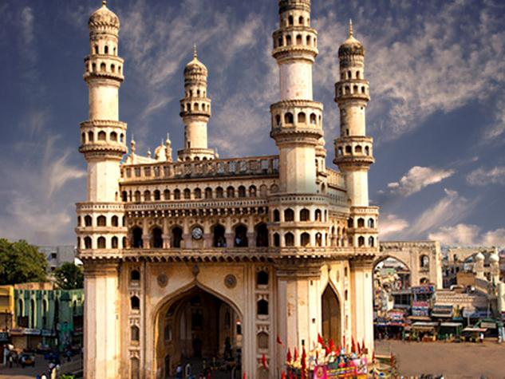
^{HYDERABAD}

Slide 2
Hyderabad
Hyderabad is the fourth largest city in
India and capital city of the Indian state
of Telangana in South India.

Slide 3
tourist attractions
Charminar
makkah masjid
Golconda Fort
Qutub Shahi Tombs
Falaknuma Palace
Birla Mandir
Nehru Zoological Park

Slide 4
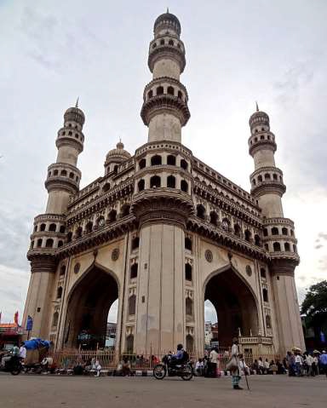
Charminar
It is built by Muhammed
Quli Qutb Shah as a
memorial for plague
victims. Charminar in
most occasions is used
to represent the city and
the state and is hailed
as a unique Deccan
monument

Slide 5
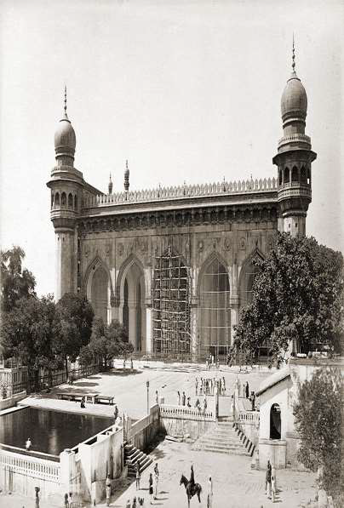
makkah masjid
Mecca Masjid was built 400
years back during the reign
of Sultan Muhammad Qutub
Shah, the 6th Qutub Shahi
Sultan of Hyderabad.
More than 8,000 workers
were employed to build the
mosque. Muhammed Qutub
Shah personally laid the
foundation stone of the
'mosque'.

Slide 6
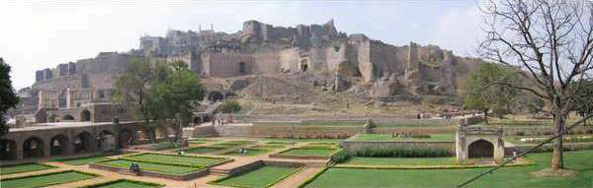
Golconda Fort
Golconda Fort is one of
the most magnificent
fortress complexes in
India. Seated on a hill
on one side and
spiraling fort on the
other, its location and
internal design made it
one of the strongest
forts in India.

Slide 7
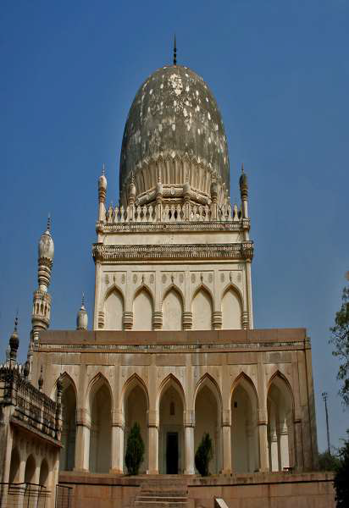
Qutub Shahi Tombs
Home to various Tombs
dedicated to Rulers of
Qutub Shahi dynasty,
located at Shaikpet,
near Golconda Fort.
These are an example
of Deccan
architecture with large
minarets, huge domes,
delicate marble
designs and multiple
inner passages.

Slide 8
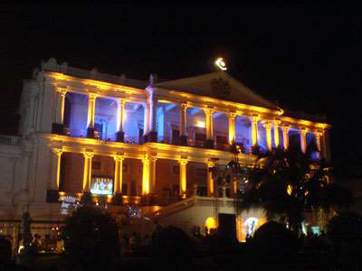
Falaknuma Palace
This is Built by an Italian
architect through one of
the Paigah nobles,
Nawab Viqar al-Umra'
complete in Italian
marble. It has now been
undertaken by Taj group
todevelop this as
Heritage Hotel.

Slide 9
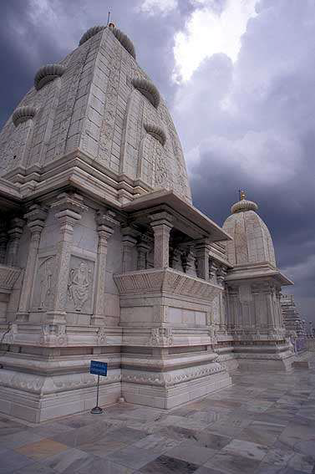
Birla Mandir
It is a Hindu
temple made
of white
marble
located on
top of a hill
overlooking
the city.

Slide 10
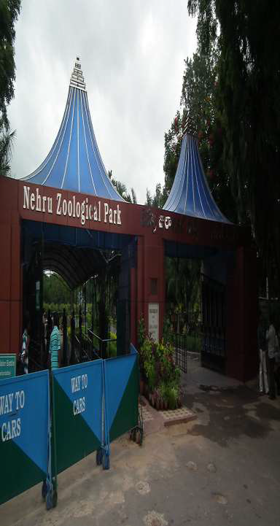
Nehru Zoological Park
This zoo is a natural
habitat housing a large
variety of animals, birds,
nocturnal species,
aquatic and amphibian
species.
•Its unique feature is the
21 in-built masonry dams
that are jewel shaped,
which were built in 1804
by Henry Russle, a
French engineer in British
service.

Slide 11


